Slide 1
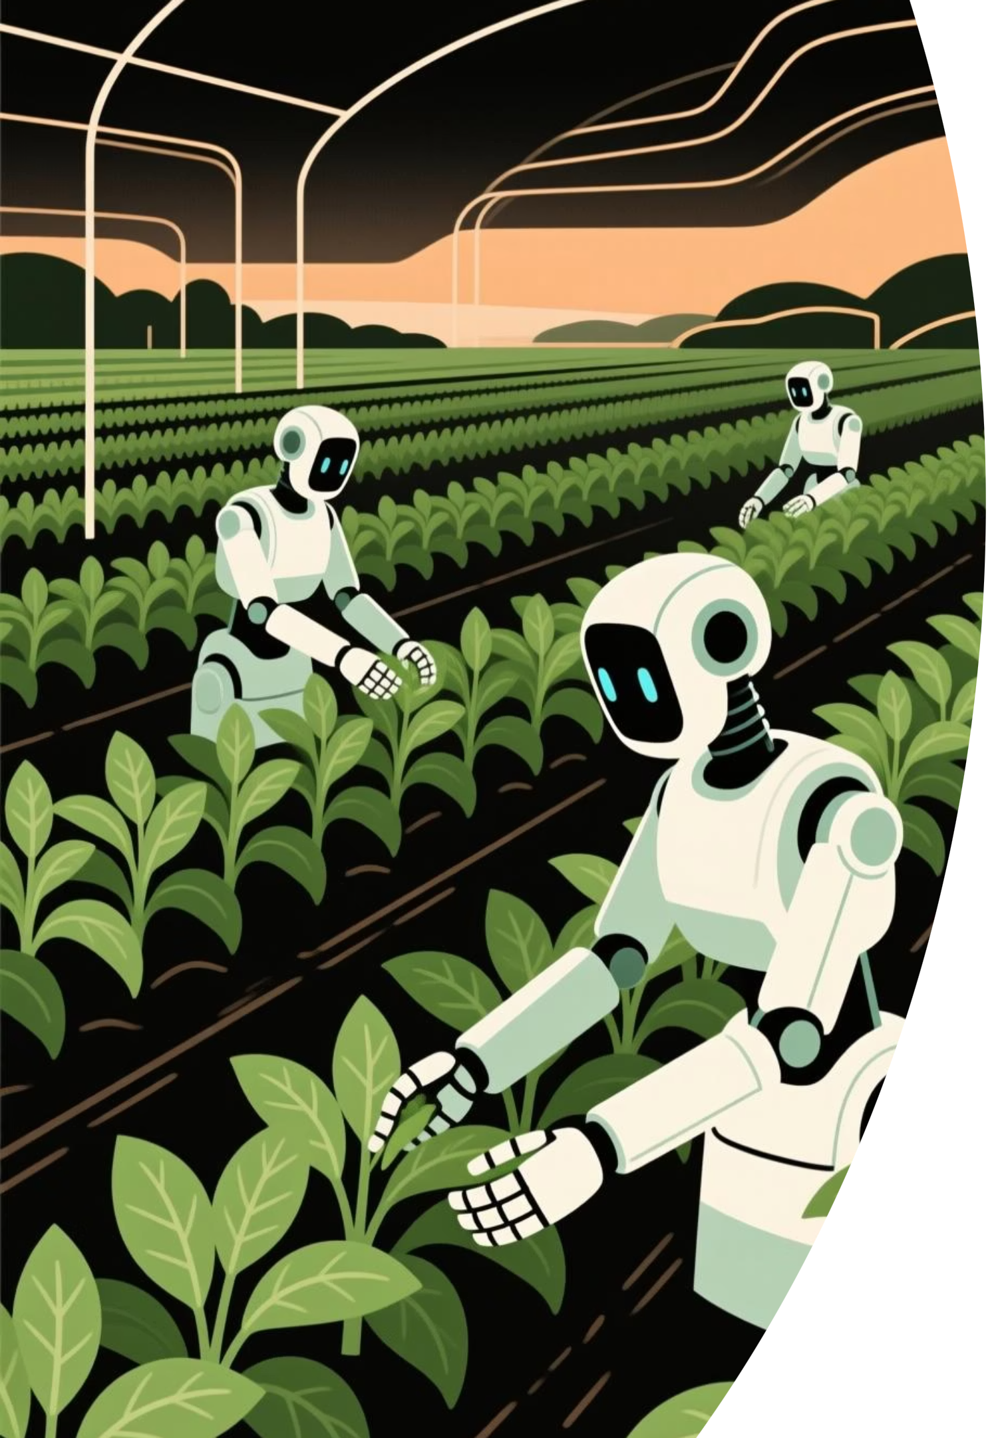
AI-AgroBot: Universal AI-based Agricultural Assistant
An intelligent web-based agricultural assistant designed to help farmers monitor crop health, detect diseases, and receive real-time insights using AI-powered image analysis.
Prepared by: Tanvi Khicchi
Infosys Springboard Internship 6.0 - AI Domain

Slide 2
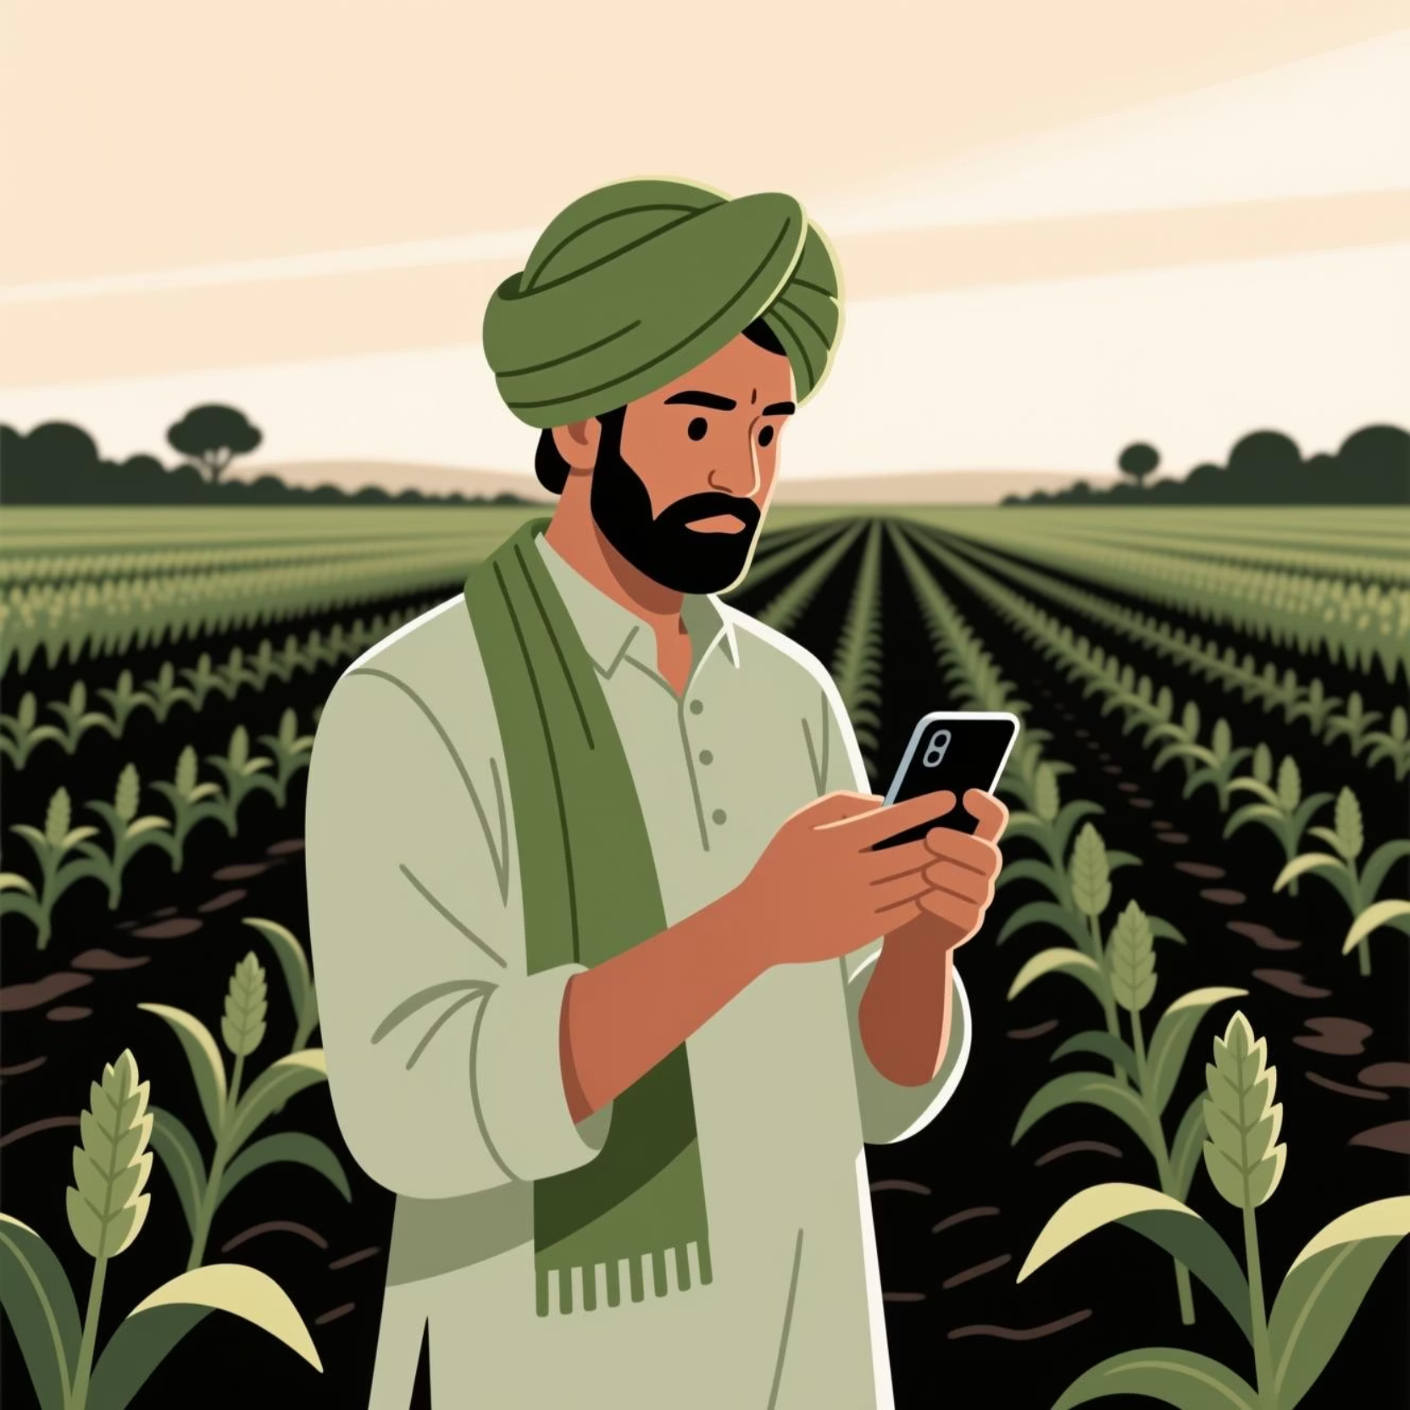
Project Vision
Making Smart Agriculture Accessible
AI-AgroBot simplifies farm management by combining an AI chatbot, image recognition, and admin dashboards for managing users and knowledge bases.
The system provides region-specific, crop-specific, and multilingual responses to farmers queries—making smart agriculture accessible to everyone.

Slide 3





Key Outcomes
AI-Driven Image Analysis
Real-Time Support
Personalized Recommendations
Detect crop stress and diseases through intelligent image processing.
Text or voice-based chatbot assistance for farmers' queries.
Tailored advice based on crop, region, and language preferences.
Admin Control
Scalable System
Comprehensive dashboard for user and knowledge base management.
Modular architecture integrating AI, databases, and web technologies.

Slide 4

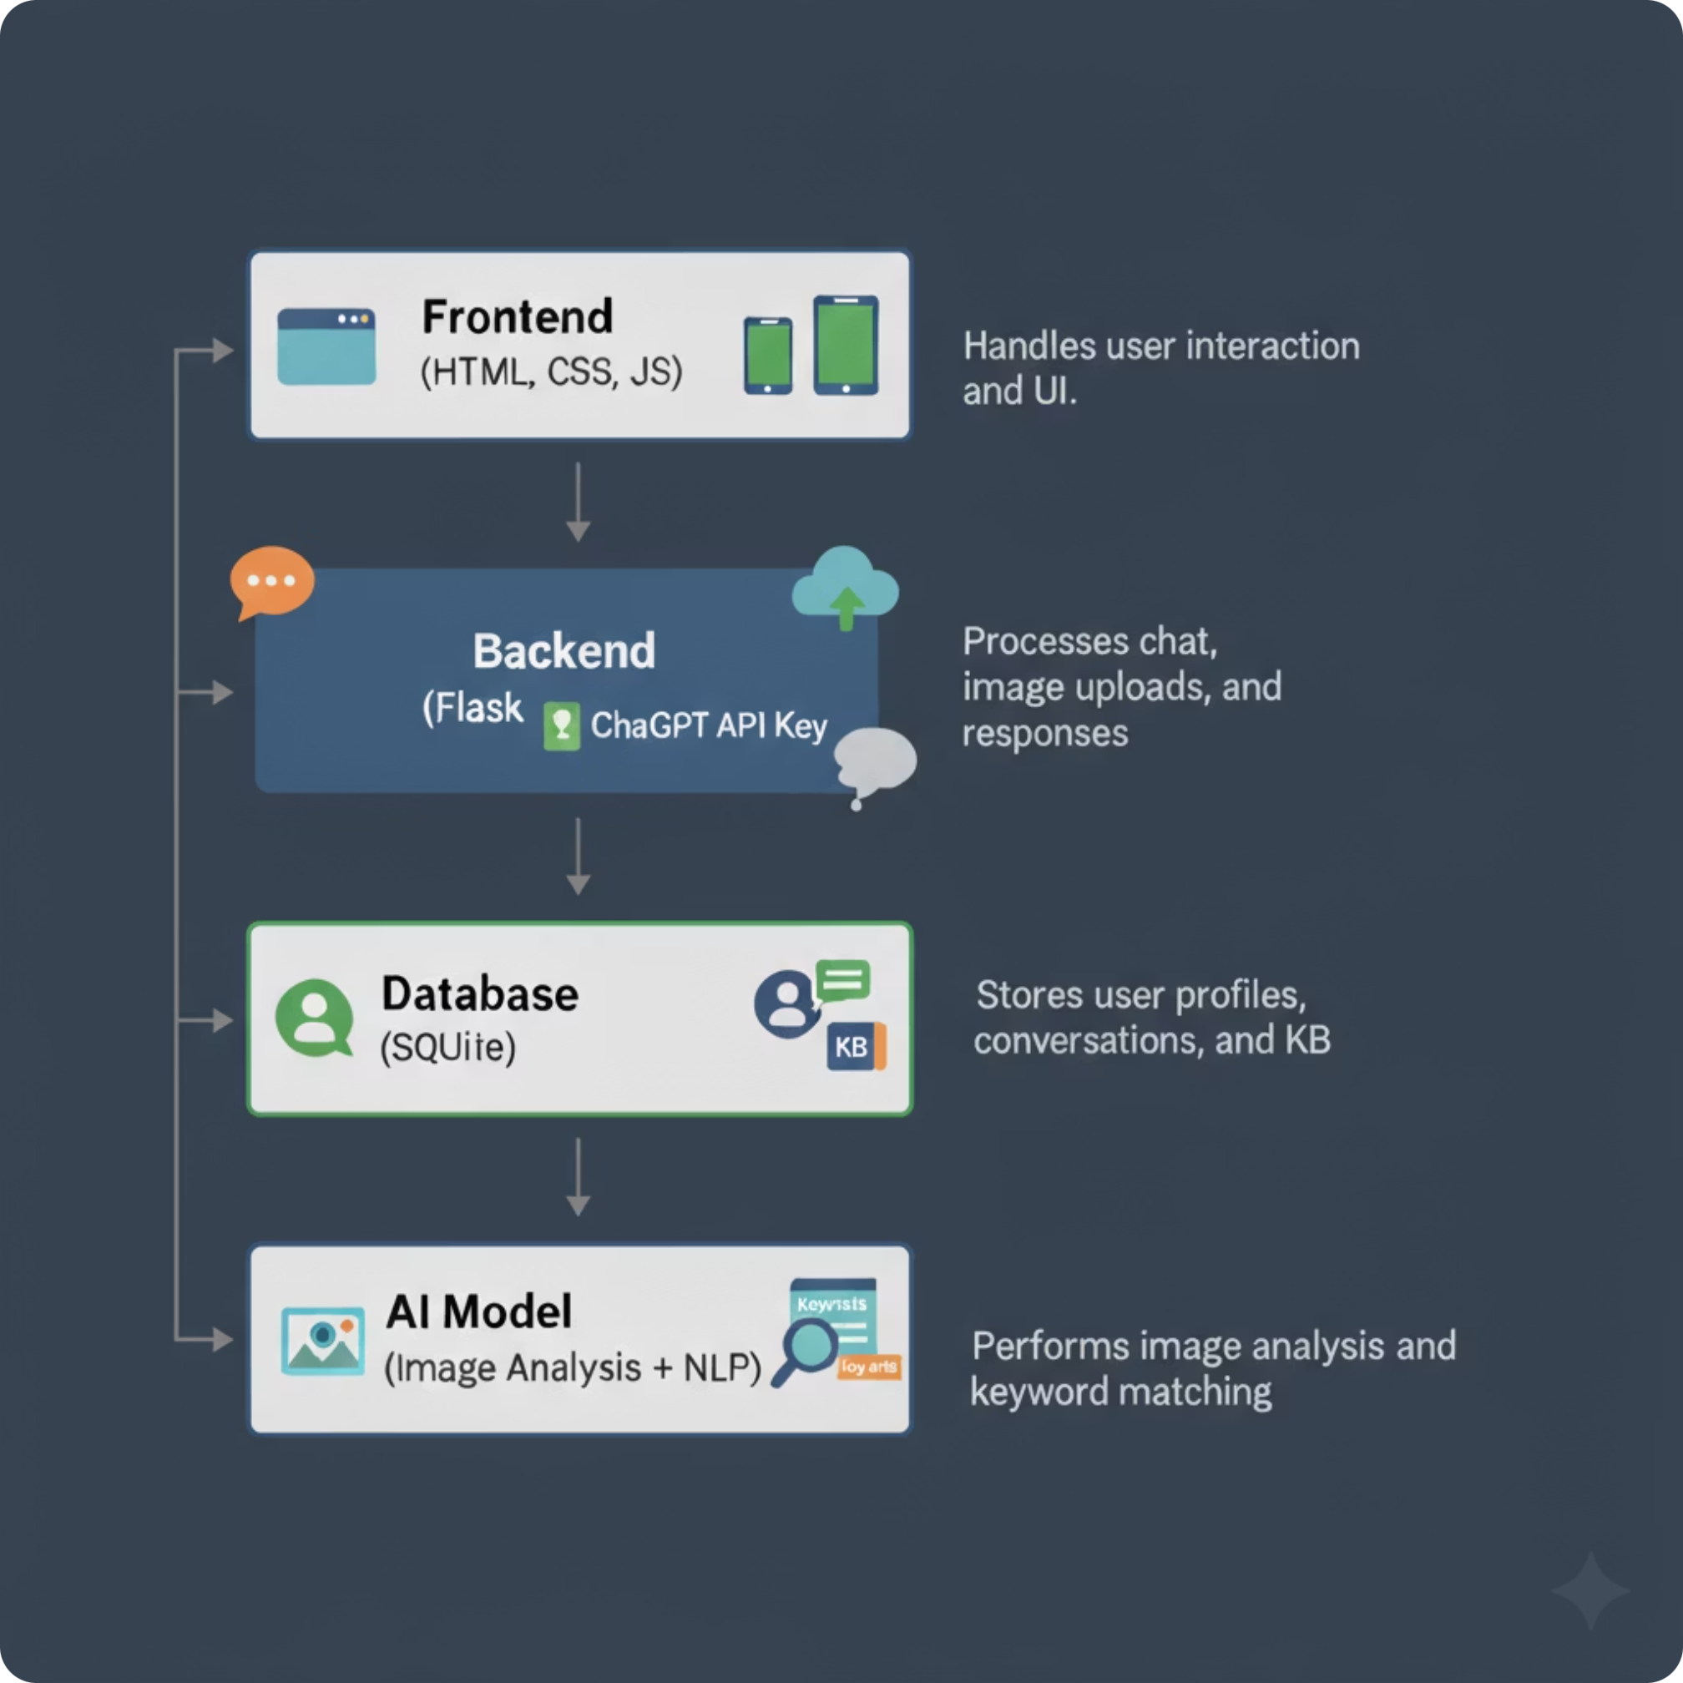




System Architecture
Frontend
User interaction and UI
Backend
Chat, image processing, responses
Database
User profiles, conversations, KB
AI Model
Image analysis, keyword matching

Slide 5
Core Modules
1
2
3
User Authentication
Chatbot Assistant
Image Analysis
Login, signup, and role-based access for farmers and admins.
AI-powered multilingual support for agricultural FAQs.
Upload crop images to detect health, disease, or stress conditions.
4
5
6
Profile Management
Admin Dashboard
Recent Conversations
Update crop, region, and language preferences.
Manage farmers, delete users, and update Knowledge Base via CSV.
View, track, and manage chat logs with timestamps.
7
Database Integration
Store user data, KB entries, and chat history securely.

Slide 6
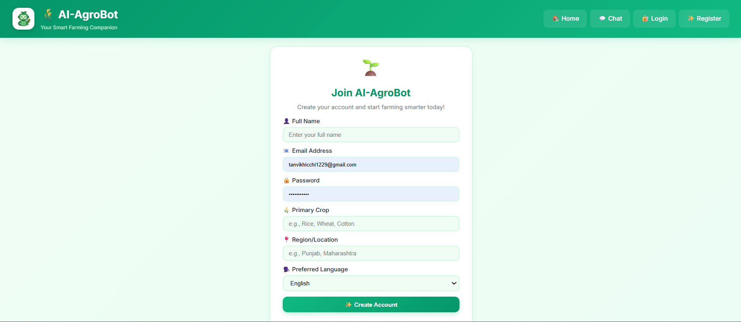
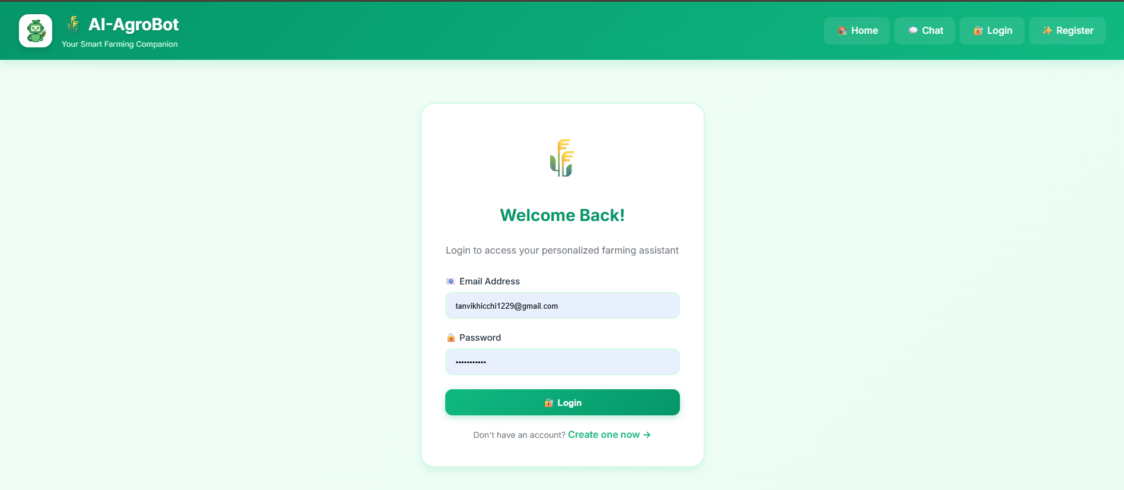
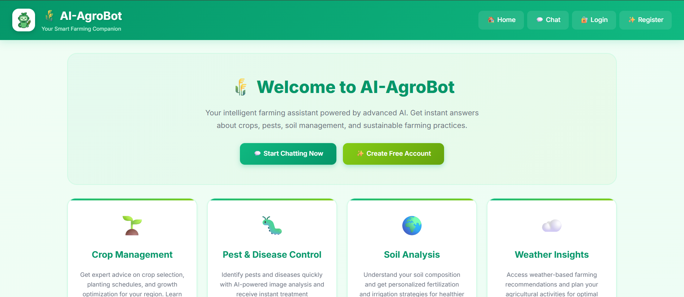
User Journey: Getting Started
Registration
Login
Dashboard
New farmers create accounts with name, email, password, and region details.
Secure access for registered users via email and password authentication.
Main hub displaying project details and quick access to all features.

Slide 7
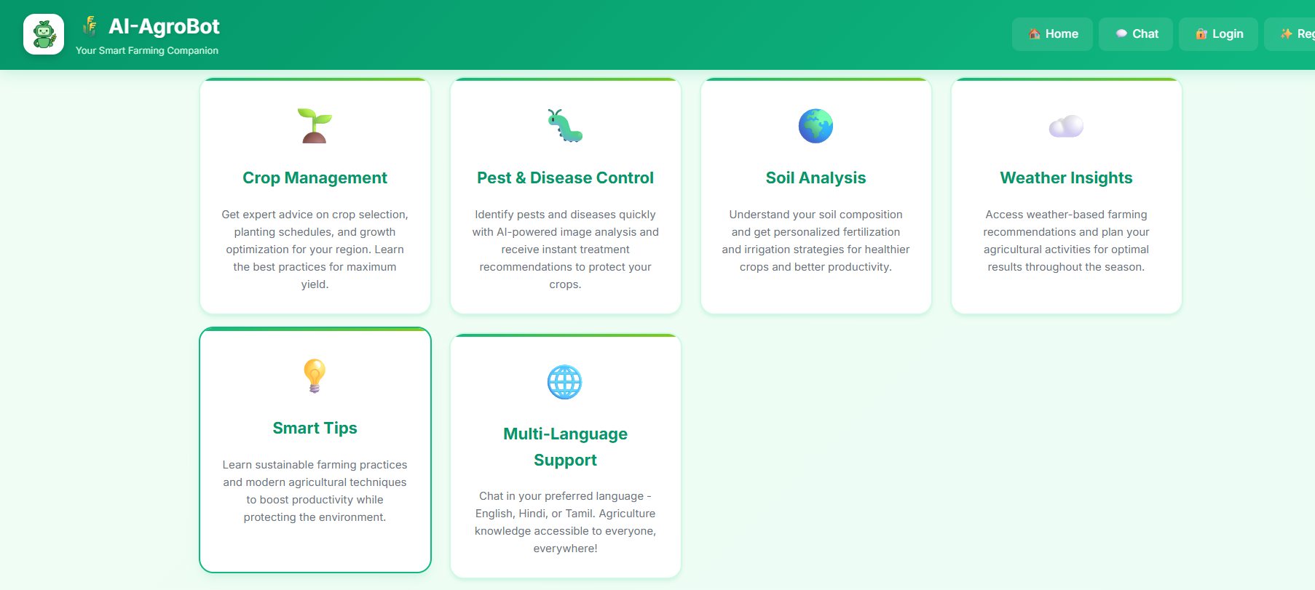
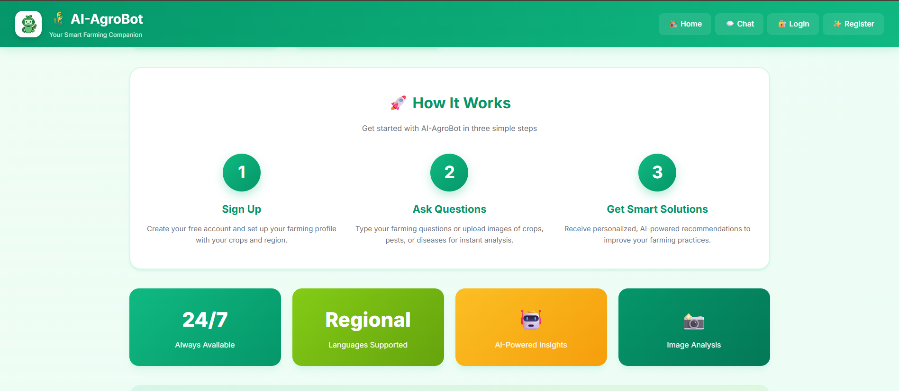
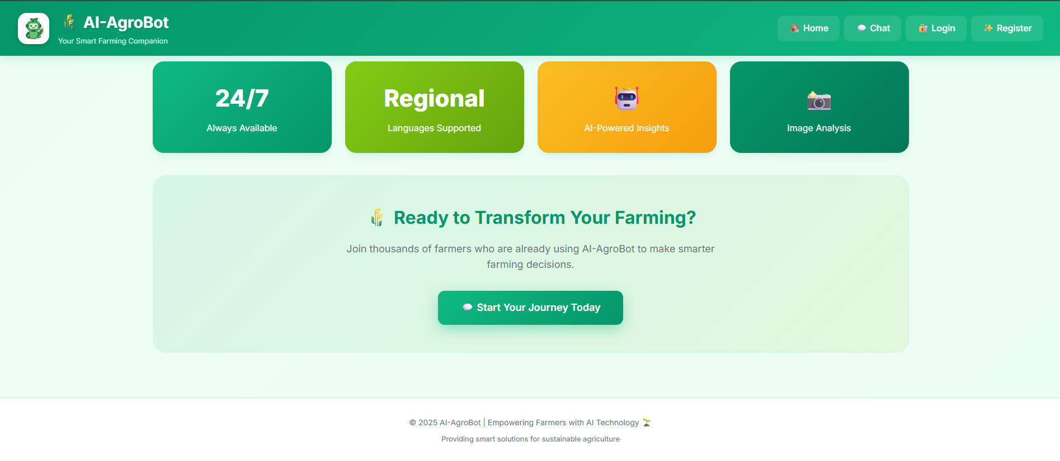
Dashboard Experience
The home dashboard provides a comprehensive overview of AI-AgroBot features, project information, and easy navigation to all core functionalities.

Slide 8

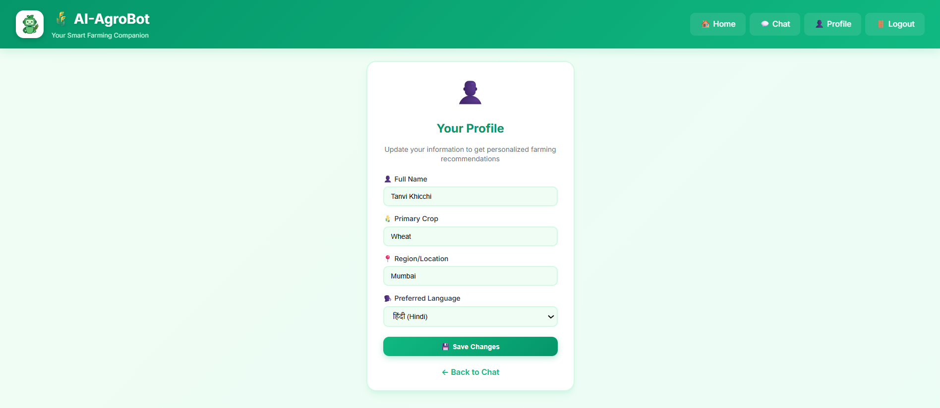
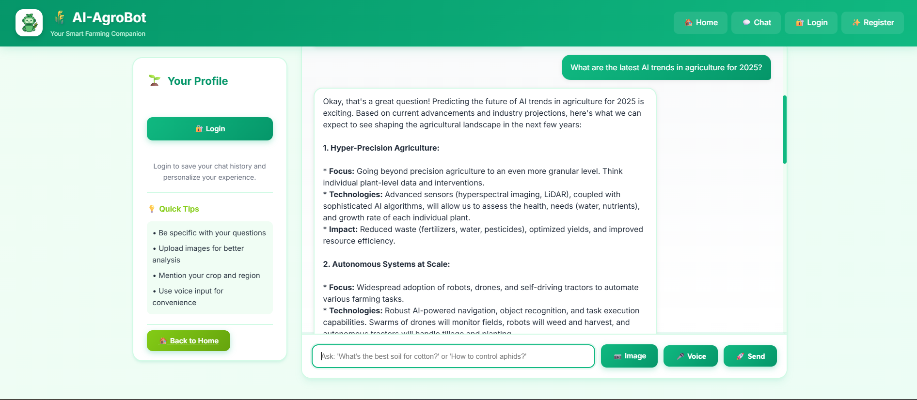
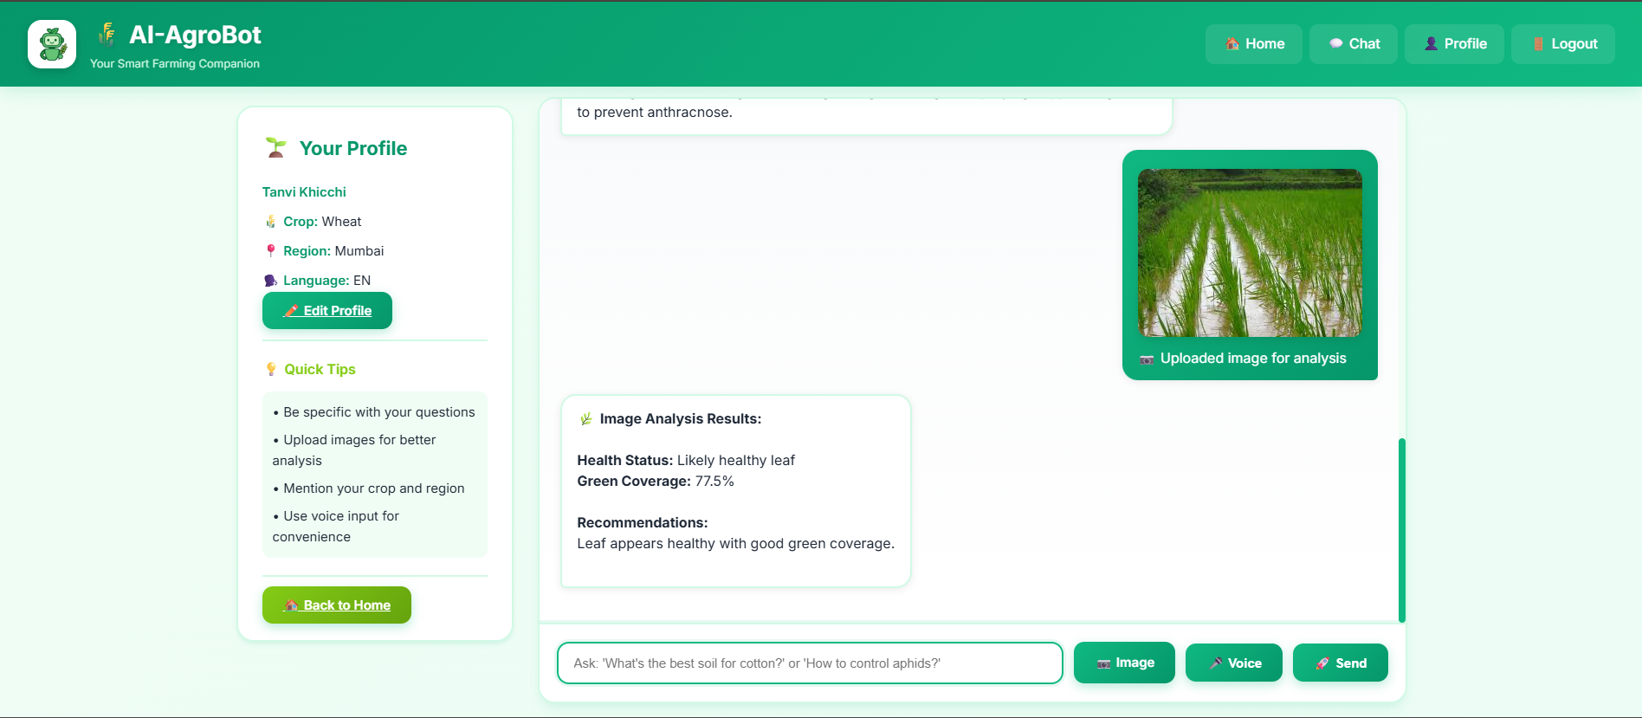
AI-Powered Features in Action
Edit Profile
Chatbot Interaction
Disease Detection
Update name, crop preferences, and details for personalized recommendations.
Ask queries about crops, fertilizers, and diseases with AI-powered responses.
Upload crop images for real-time AI analysis with confidence scores and solutions.

Slide 9
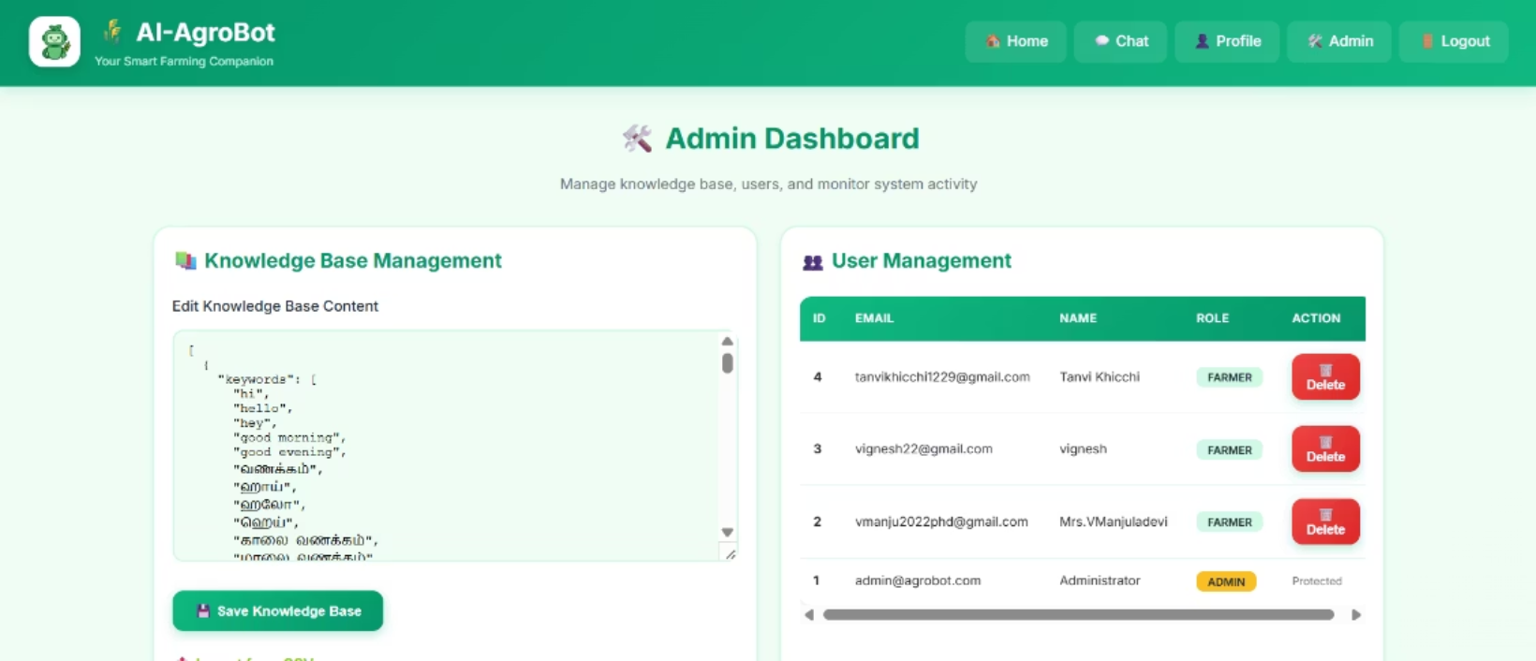
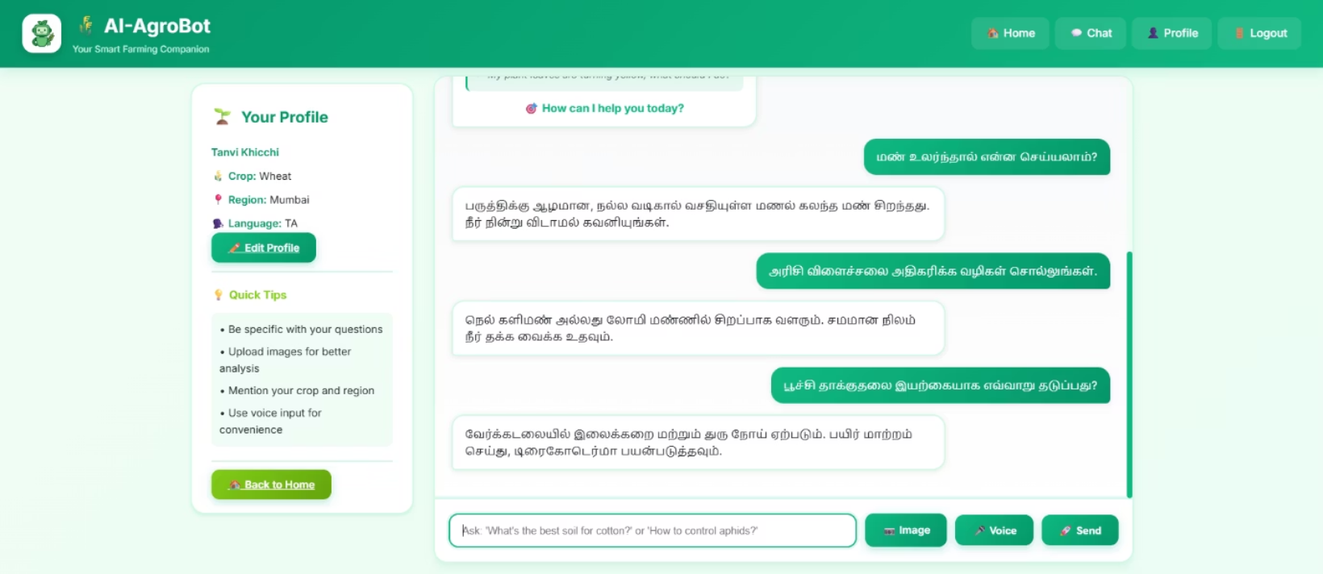
Admin Control & Multilingual Support
Admin Dashboard
Multilingual Interface
Comprehensive admin functionalities including user management, chatbot activity monitoring, and knowledge base updates.
Support for multiple Indian languages makes the platform accessible to all farmers across regions.

Slide 10

Project Credits
Submitted By
Tanvi Khicchi
B.E. Information Technology (2023 – 2027)
Don Bosco Institute of Technology, Mumbai
Internship Program
Infosys Springboard Artificial Intelligence Domain

